Slide 1

Stored procedures and indexing commands
Database Management System | SQL and Advanced Query Formulation
Course: Database Management System (DBMS) | Chapter: SQL and Advanced Query Formulation | Program: Bachelor of Engineering
DISCOVER · LEARN · EMPOWER
Notes:
Welcome to today's lecture on SQL and Advanced Query Formulation. We will dive deep into two critical components: stored procedures and indexing commands. These tools are essential for building scalable and efficient database applications in the real world. Let us begin by understanding how they map to our course outcomes.

Slide 2
Course Outcomes
SLIDE 2 / 14
Course Outcome
CO | BT LEVEL | DESCRIPTION
CO1 | BT2 | Explain database architecture, relational model concepts and formal query language foundations including relational algebra and relational calculus.
CO2 | BT3 | Apply relational algebra, relational calculus and SQL constructs to formulate correct and efficient database queries.
CO3 | BT4 | Analyze functional dependencies and design normalized relational schemas up to 5NF ensuring lossless join and dependency preservation.
CO4 | BT4 | Analyze transaction schedules and concurrency control mechanisms to determine serializability, recoverability and correctness.
CO5 | BT5 | Evaluate storage structures, indexing strategies and query optimization techniques for performance, scalability and reliability.
Chandigarh University
2 / 14
Notes:
Today's session directly addresses CO4 and CO5. We will analyze how stored procedures ensure transaction correctness and how indexing strategies optimize performance. Understanding these concepts is vital for determining the reliability of any database system you design. Please note these outcomes as we proceed through the technical details.

Slide 3
Learning Objectives
SLIDE 3 / 14
Learning Outcomes
1
Define stored procedures and explain their role in encapsulating SQL logic.
2
Analyze the performance benefits of indexing strategies on query execution time.
3
Construct complex stored procedures handling error management and transaction control.
4
Evaluate trade-offs between different indexing types for specific query patterns.
5
Demonstrate the creation and execution of indexed views for optimization.
Chandigarh University
3 / 14
Notes:
By the end of this lecture, you will be able to define stored procedures and explain their role in encapsulating SQL logic. We will analyze the performance benefits of indexing strategies on query execution time. You will also learn to construct complex stored procedures handling error management and transaction control. Finally, we will evaluate trade-offs between different indexing types for specific query patterns.

Slide 4
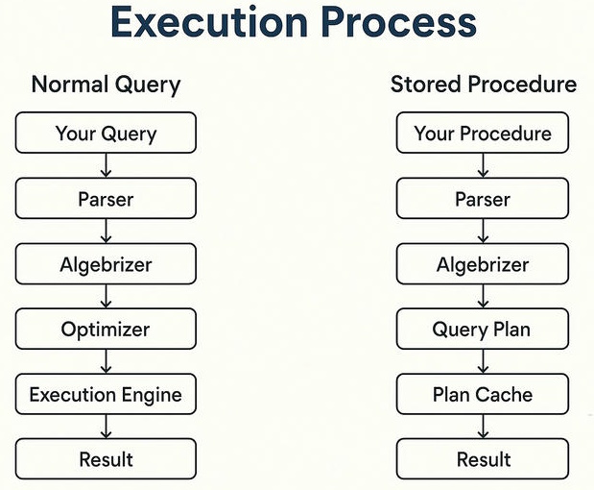
Lecture
SLIDE 4 / 14
Stored Procedures Definition and Benefits
1
A stored procedure is a named group of SQL statements precompiled for storage.
2
It reduces network traffic by sending only the procedure name instead of code.
3
It enhances security by allowing users to execute logic without direct table access.
4
It promotes code reusability across multiple applications and database sessions.
5
It centralizes business logic within the database server for better maintenance.
Execution Process of SQL Queries vs Stored Procedures
Chandigarh University
4 / 14
Notes:
Think of a stored procedure as a pre-packaged function in your database. Instead of sending a long SQL query every time, you just send the name. For example, sending 'EXECUTE GetStudentDetails(101)' is much faster than sending the full SELECT statement. This reduces network traffic significantly and enhances security by restricting direct table access.

Slide 5
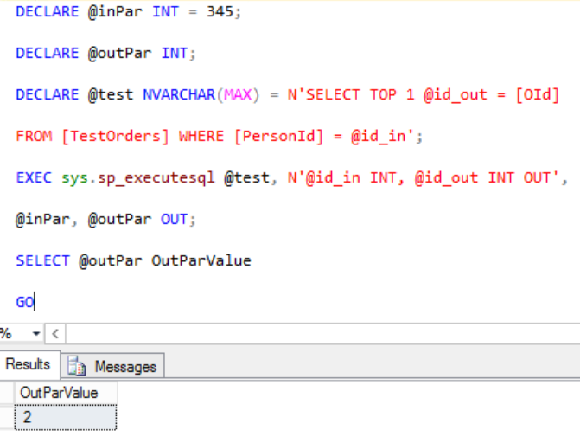
Lecture
SLIDE 5 / 14
Syntax and Creation of Stored Procedures
1
Use CREATE PROCEDURE statement to define the procedure name and parameters.
2
Parameters can be input (IN), output (OUT), or input-output (INOUT).
3
The body contains standard SQL statements like SELECT, INSERT, or UPDATE.
4
Use BEGIN and END blocks to group multiple statements logically together.
5
Parameters allow dynamic data passing without hardcoding values in the script.
Source: media.geeksforgeeks.org
Chandigarh University
5 / 14
Notes:
To create a procedure, you use the CREATE PROCEDURE statement followed by the name. You can define parameters as input, output, or input-output types. The body contains standard SQL statements grouped within BEGIN and END blocks. For instance, a parameter allows dynamic data passing without hardcoding values in the script.

Slide 6
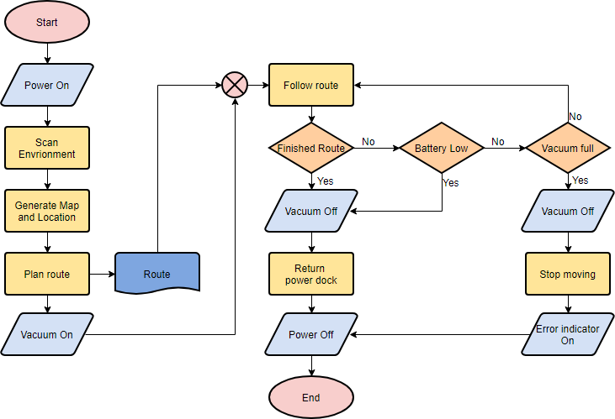
Worked Example
SLIDE 6 / 14
Stored Procedure Logic
GOVERNING EQUATION
Logic calculates new salary: New = Old × (1 + Percentage / 100)
EXAMPLE
Old salary 50000 with 10% increase results in 55000.
• Procedure 'UpdateSalary' takes employee ID and percentage increase as inputs.
• Transaction control ensures data consistency if the update fails midway.
• Error handling returns specific messages for invalid IDs or negative percentages.
Source: www.visual-paradigm.com
Chandigarh University
6 / 14
Notes:
Consider a procedure named UpdateSalary that takes an employee ID and a percentage increase. The logic calculates the new salary using the formula: New = Old × (1 + Percentage / 100). For example, an old salary of 50000 with a 10% increase results in 55000. Transaction control ensures data consistency if the update fails midway.

Slide 7
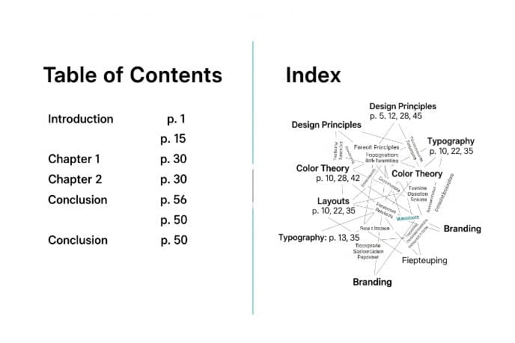
Lecture
SLIDE 7 / 14
Indexing Commands and Purpose
1
An index is a data structure that improves the speed of data retrieval.
2
It acts like a book index, pointing directly to the location of data.
3
CREATE INDEX command creates a new index on one or more columns.
4
Indexes reduce the number of disk pages scanned during query execution.
5
They are crucial for optimizing WHERE, JOIN, and ORDER BY clauses.
Source: thebookcoverdesigner.com
Chandigarh University
7 / 14
Notes:
An index is a data structure that improves the speed of data retrieval. It acts like a book index, pointing directly to the location of data. The CREATE INDEX command creates a new index on one or more columns. Indexes reduce the number of disk pages scanned during query execution, making them crucial for optimizing WHERE, JOIN, and ORDER BY clauses.

Slide 8
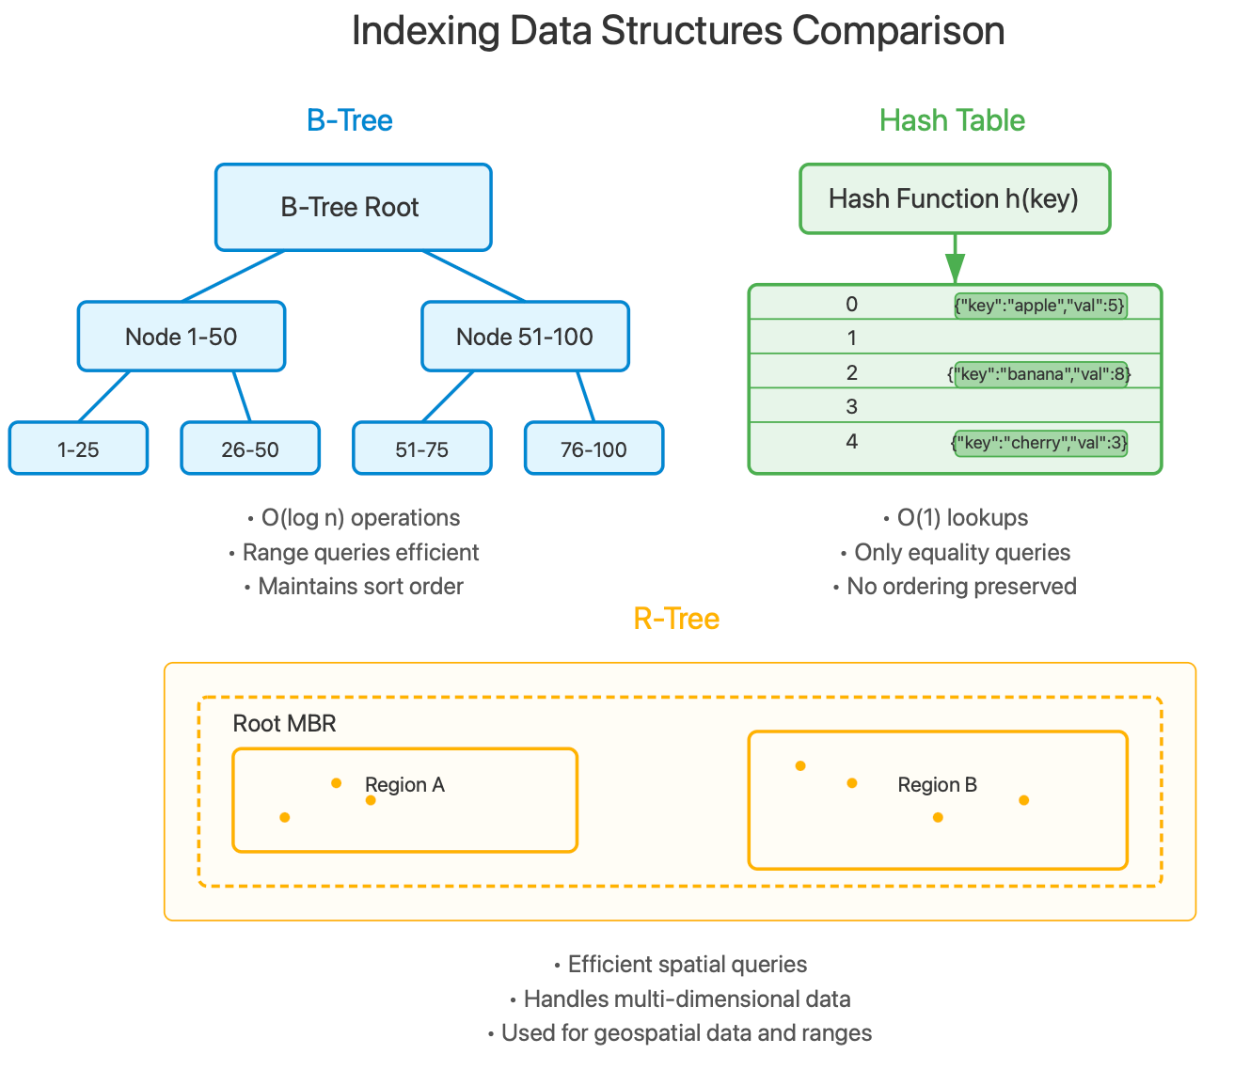
Types of Indexes
SLIDE 8 / 14
B-Tree and Hash
1
B-Tree indexes are balanced trees supporting range queries and sorting efficiently.
2
Hash indexes use hash tables for extremely fast equality lookups only.
3
B-Tree is the default choice for most general-purpose database queries.
4
Hash indexes cannot support range queries or sorting operations effectively.
5
Composite indexes cover multiple columns to optimize complex multi-column filters.
Source: substackcdn.com
Chandigarh University
8 / 14
Notes:
B-Tree indexes are balanced trees supporting range queries and sorting efficiently. Hash indexes use hash tables for extremely fast equality lookups only. B-Tree is the default choice for most general-purpose database queries. Hash indexes cannot support range queries or sorting operations effectively, so choose wisely based on your query patterns.

Slide 9
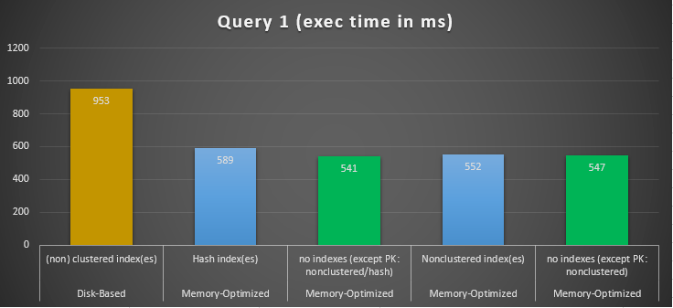
Worked Example
SLIDE 9 / 14
Indexing Performance
QUERY WITHOUT INDEX SCANS ALL ROWS
1,000,000 comparisons required.
• Table 'Students' has 1,000,000 rows without an index on 'RollNo'.
• Query with B-Tree index on 'RollNo' requires ~20 comparisons (log2(1M)).
• Performance gain is approximately 50,000 × faster for this specific query.
• Overhead exists for INSERT/UPDATE operations due to index maintenance.
Source: codingsight.com
Chandigarh University
9 / 14
Notes:
Consider a table with 1,000,000 rows without an index on 'RollNo'. A query without an index scans all rows, requiring 1,000,000 comparisons. With a B-Tree index, it requires only about 20 comparisons, which is log2(1M). This results in a performance gain of approximately 50,000 × faster for this specific query. However, note the overhead for INSERT and UPDATE operations due to index maintenance.

Slide 10

Lecture
SLIDE 10 / 14
Common Pitfalls in Indexing Strategies
1
Over-indexing slows down write operations and consumes excessive storage space.
2
Indexing low-cardinality columns like 'Gender' often yields poor performance.
3
Leading wildcards in LIKE queries (e.g., '%text') prevent index usage.
4
Ignoring query patterns leads to indexes that are never utilized by the optimizer.
5
Composite indexes must follow the leftmost prefix rule for effective usage.
Source: static.vecteezy.com
Chandigarh University
10 / 14
Notes:
Over-indexing slows down write operations and consumes excessive storage space. Indexing low-cardinality columns like 'Gender' often yields poor performance. Leading wildcards in LIKE queries prevent index usage, so avoid patterns like '%text'. Ignoring query patterns leads to indexes that are never utilized by the optimizer, wasting resources.

Slide 11
Lecture
SLIDE 11 / 14
Stored Procedures and Transaction Control
1
Stored procedures can encapsulate BEGIN TRANSACTION and COMMIT logic.
2
They ensure atomicity by rolling back changes if any step fails.
3
Concurrency control mechanisms prevent data corruption during simultaneous updates.
4
Isolation levels define how transactions interact with each other in the system.
5
Procedures simplify error handling by centralizing rollback logic in one place.
Chandigarh University
11 / 14
Notes:
Stored procedures can encapsulate BEGIN TRANSACTION and COMMIT logic to ensure atomicity. They ensure atomicity by rolling back changes if any step fails, maintaining data integrity. Concurrency control mechanisms prevent data corruption during simultaneous updates. Procedures simplify error handling by centralizing rollback logic in one place, making the code more robust.

Slide 12
Lecture
SLIDE 12 / 14
Optimization Techniques for Indexes
1
Use EXPLAIN plans to analyze how the database executes your queries.
2
Covering indexes include all columns needed, avoiding table lookups entirely.
3
Filtered indexes apply only to a subset of rows for better efficiency.
4
Regular maintenance like REINDEX prevents fragmentation and maintains performance.
5
Query rewriting can sometimes eliminate the need for specific indexes.
Chandigarh University
12 / 14
Notes:
Use EXPLAIN plans to analyze how the database executes your queries effectively. Covering indexes include all columns needed, avoiding table lookups entirely for faster access. Filtered indexes apply only to a subset of rows for better efficiency. Regular maintenance like REINDEX prevents fragmentation and maintains performance over time.

Slide 13
Lecture
SLIDE 13 / 14
Key Takeaways
1
Stored procedures encapsulate logic, reduce network traffic, and enhance security.
2
Indexes drastically improve read performance but add overhead to write operations.
3
B-Tree is versatile for ranges, while Hash is best for equality checks.
4
Proper index design requires understanding query patterns and data cardinality.
5
Transaction control within procedures ensures data consistency and reliability.
Chandigarh University
13 / 14
Notes:
Stored procedures encapsulate logic, reduce network traffic, and enhance security significantly. Indexes drastically improve read performance but add overhead to write operations, so balance is key. B-Tree is versatile for ranges, while Hash is best for equality checks. Proper index design requires understanding query patterns and data cardinality to be effective.

Slide 14
Lecture
SLIDE 14 / 14
References
1
Fundamentals of Database Systems — Ramez Elmasri & Shamkant B. Navathe
2
Database System Concepts — Silberschatz, Korth & Sudarshan
3
Database Management Systems — Raghu Ramakrishnan & Johannes Gehrke
4
Oracle/MySQL Documentation — Oracle
Chandigarh University
14 / 14
Notes:
For further reading, please refer to the standard textbooks listed here. These resources provide comprehensive coverage of database theory and practical implementation details. The Oracle and MySQL documentation will give you specific syntax details for these systems. Thank you for your attention, and I am available for any questions.

